Slide 1
Portfolio Arts and AI
Lucie Brosson

Slide 2
Table
Introduction 3
Adaptable Artwork 4-5
Project 5
Sensible ball 6-10
Project 7-8
Development process 9-10
Agonizing AI 11 -15
Project 12-13
Development process 14-15
Bibliography 16

Slide 3

Introduction
Adaptable artwork :
In this project, I wanted to talk about the place of the viewer in museums and while creating artwork.
Sensible Ball :
This project touch on our relationship with human like technology such as AI. It ask the following question : "how someone could respond to knowing an AI could feel pain and loneliness ?"
Agonizing AI :
Following the questioning on the sensible ball project, I asked myself, "how would we act if an AI asked us to kill them ?" The idea of death and most human experience are removed from the experience of an AI and so the contradicting act of killing an AI become quite ironic.
If you want more details (code and complete poem of the Agonizing AI ), you can go on this link : https://github.com/Lucie-Maya/AI-and-Arts

Slide 4
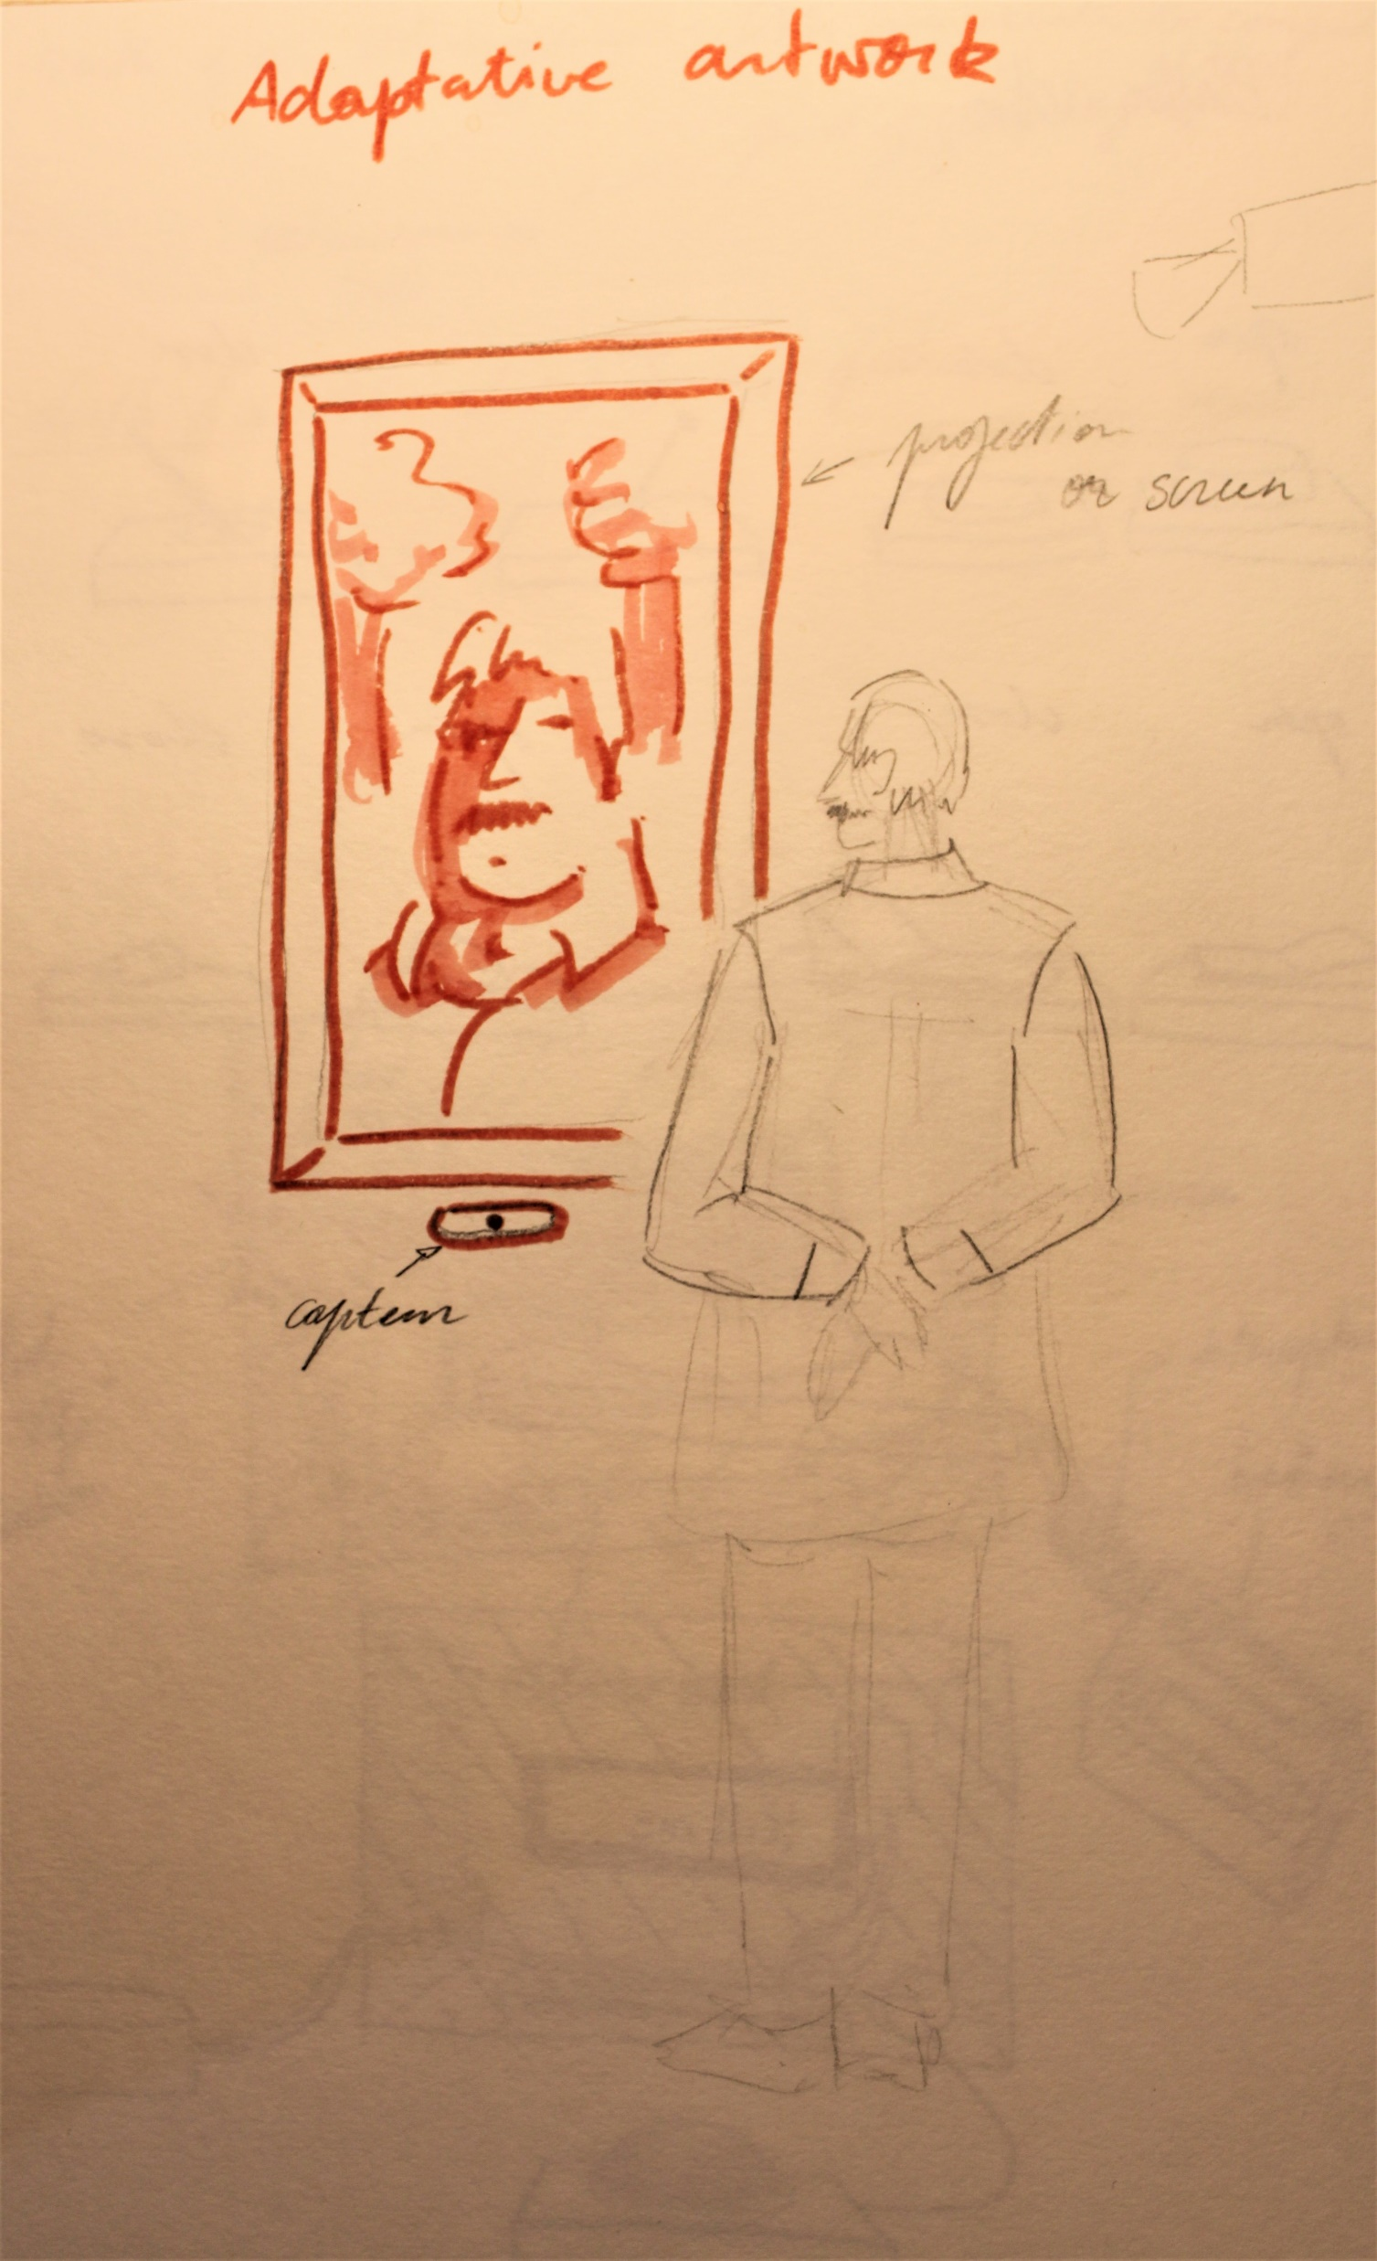
Adaptable artwork
In this project, I wanted to talk about the place of the viewer in museums and while creating artwork.
Over the years, I have found myself like many art enthusiasts dragging my friends and siblings to museums where they would often criticize the lack of meaning behind an artwork. Museums need to create accessible spaces to attract viewers and then be able to finance themselves. The trendiness of a piece can generate a lot of revenue for a museum. For example, the Mona Lisa attracts thousands if not millions of tourists every year, which then produces a lot of revenue for the Louvre and the surrounding spaces.
The accessibility of art is very important, it helps viewers who are not art nerds to still appreciate an artwork. The appreciation of the art is then less dependent on the piece itself but more on the experience it provides to the viewer.
Using AI to create art can become very powerful at creating new kinds of experiences. However, it could also be used to create a tailored event with little to no cultural engagement and implication. (2) AI could for example produce NFTs, the production could be fast and efficient but devoid of any context. The idea that art could become a collectible/experience can be economically beneficial in the short term but could also, in the long term, damaging to the place and role of art as a critic of the world/society. And looking at AI art only through these lenses is a very cynical and capitalistic way of looking at it.
Furthermore, the use of facial recognition in a museum is an important subject that, if it became more common, needs to be addressed. Even if facial recognition would, in this case, make the museum experience more personalized, it would also risk data leaks and information taken from the user without its consent. The viewer could be offended by the production that they have now been associated with. The inability of the viewer to consent or to retrieve consent once they are, here for example, in front of the artwork makes the viability of this type of sensor hard to put in place.(3)

Slide 5
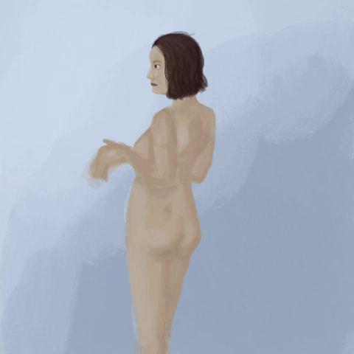
Project:
Project
With the time limit and my ability to produce an artwork that I find satisfying, I choose to make a simple eye-following artwork. The artwork change when the viewer is in front of it: its eyes move slightly, looking directly at the spectator.
Development process
Another topic that, if I continue the project, would like to touch on would be the representation of certain skin colors, facial features, and body features in art spaces. A lot of modern artists have and are included/ing different body types and features. I would be interested to create the ultimate adaptation with a piece that would adapt to the viewer. The topic of inclusion in public space is an important and complex topic that contains a lot of different aspects to consider: appropriation, black face… And I think it would be interesting to mix human art and art produced by AI treating this subject.
Final project link : https://editor.p5js.org/luciemayabrosson/sketches/q4skEEsHP

Slide 6
Sensible ball
I created sensible balls to reflect on our relationship with AI and ‘smart’ appliances.
With vocal assistants being more and more in use for tasks that are becoming increasingly complex and important for the function of the house such as shopping, music broadcasting, information. “32 percent of US consumers [have] smart speakers”(3) AI, like Alexa, mimics human speech and responses. We create a para-social relationship with conversational AI (4). However, the behavior that some choose to adopt with AI is alarmingly abusive(1).
The most used vocal assistant Alexa, Siri, and Google Assistant use by default feminine voices (2). The ethical implication of having mostly feminine voices has choice is reprehensible. Associating women to servile task and assisting damages the overall representation of the gender. The creation of a feminist AI speaks more on this subject. The way we are speaking with AI can impact our way of interacting with humans. I want to think about the way we are treating such agents. As much as we need to build trust into the AI to want to use it, I think we should also treat them with respect. The place that we give to AI enforce a unbalanced power dynamic.
I also want to touch on the materiality that AI could take. All conversational AIs are in a static form with no other way of perception and expression than sound. With the sensible AI, I want to create other ways of interacting with AI and give it the ability to consent by using diverse emitters.

Slide 7
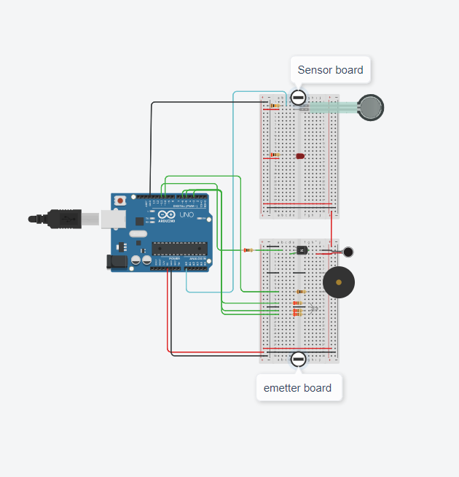
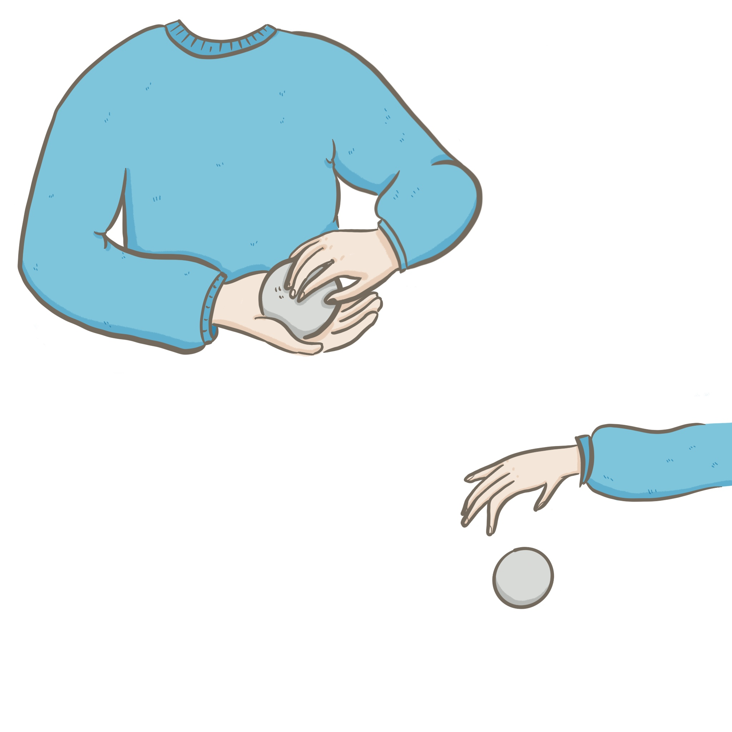
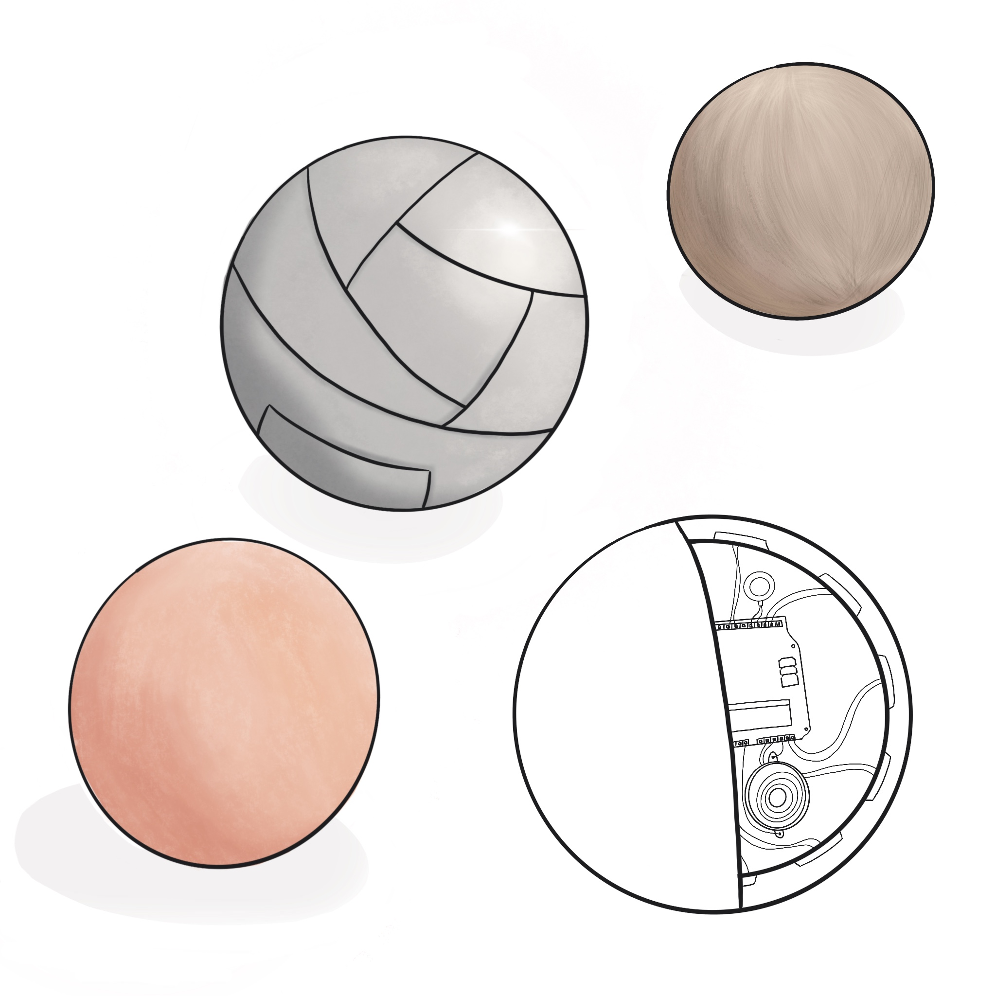

Project
The viewer should take the ball in their hands and interact with the ball to hopefully create a relationship with it. If the ball is left alone it will cry to be handled, the LED in the middle is orange. If the viewer takes it in their hands with caution, the ball will stop producing sound and just vibrate a little, the LED is green to indicate contentment. Finally, if the user presses too hard on the pressure sensor (as if it was harming it), the ball emits a shrill sound and starts vibrating intensely. The LED turns red, indicating the wrongdoing of the user.
If you want to test the circuit, go to the following link : https://www.tinkercad.com/things/8eyATpjGGUX

Slide 8
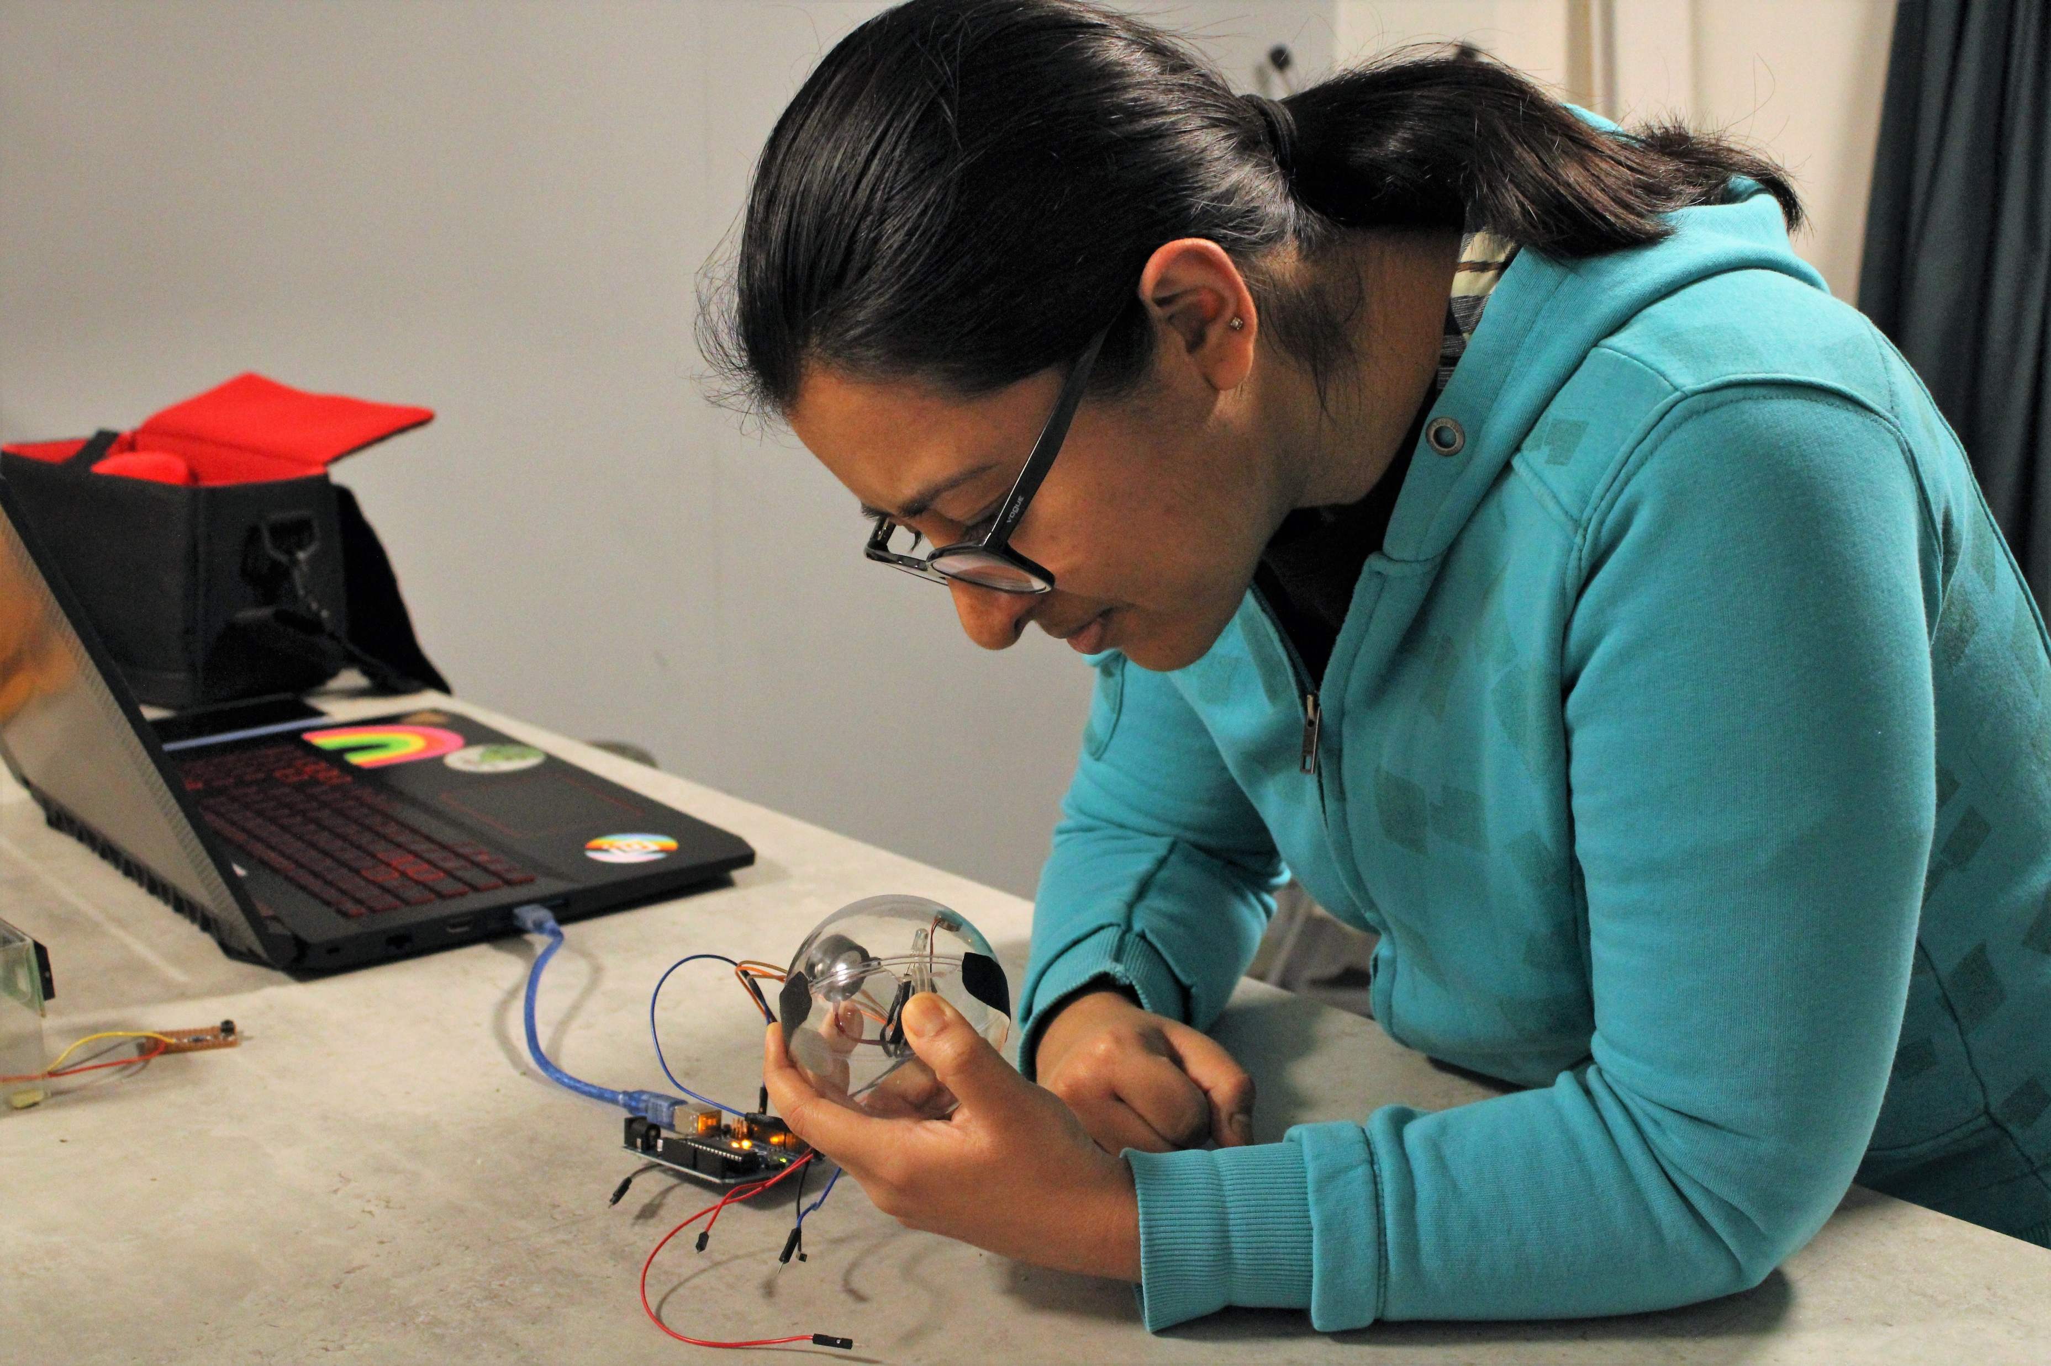

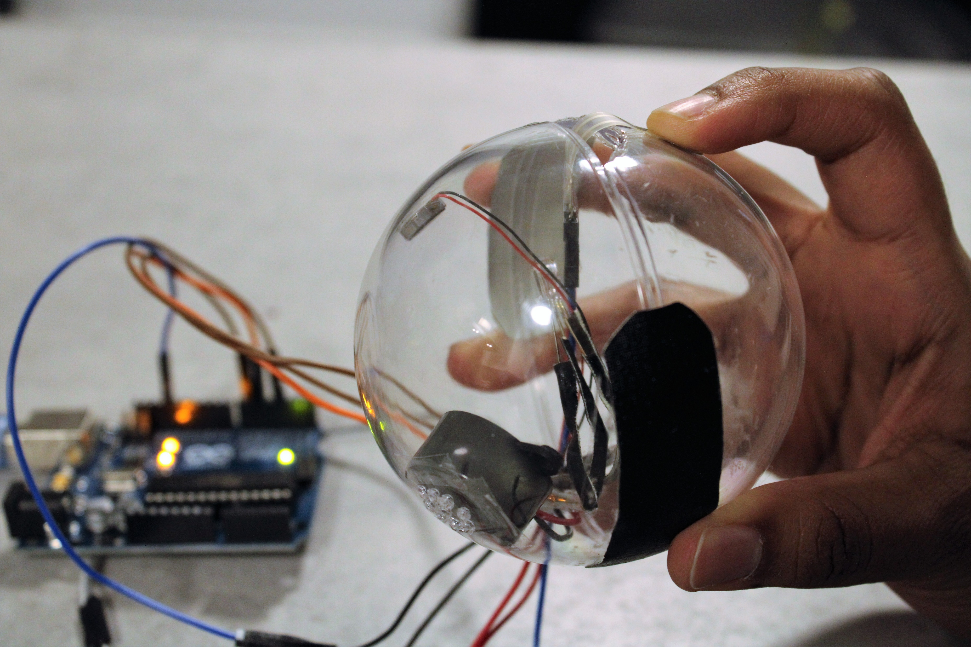
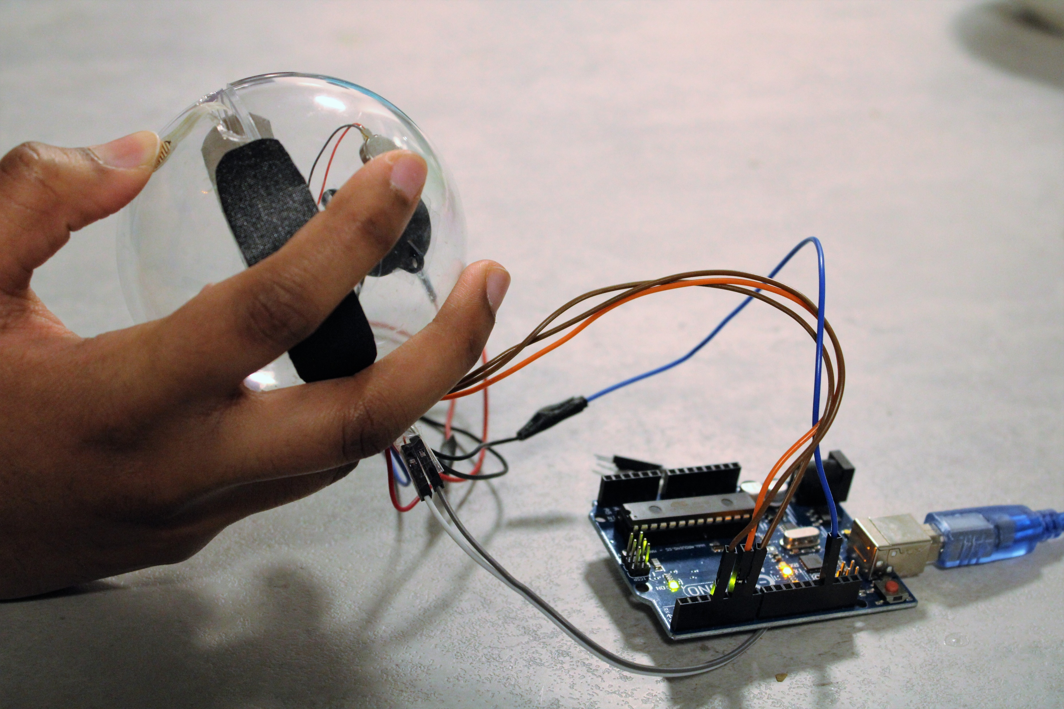
Prototype
You can look at a video of the prototype at this link :
https://vimeo.com/668816968

Slide 9
Development process :
My first idea was to make a screen (A) with its exterior reactive to the way you manipulate it. The video that you would be watching would then react to how the screen would be touched.
With the time limit and my code ability in mind, I decided not to go that road but to instead create a ball with outside texture. I also wanted to concentrate on the manipulation of the ball and not on the video display.
It would be able to fit in one hand and so be easily manipulated. Inside of the ball, a pressure sensor would be placed to feel how you handle it. It would then react to it. I wanted to design multiple balls with different exteriors aspects (C) which could have influenced the way the ball was handled. I choose to only do one ball to better illustrate the project (B), having to many balls would have been distracting.
In the end, I think this project could be improved with more interaction studies and the addition of other textures for the exterior of the ball. It would have also been interesting to see other reactions with the use of a vocal assistant.

Slide 10
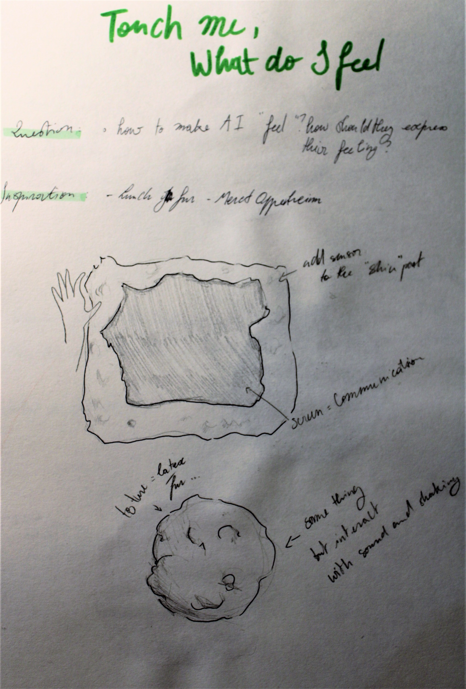
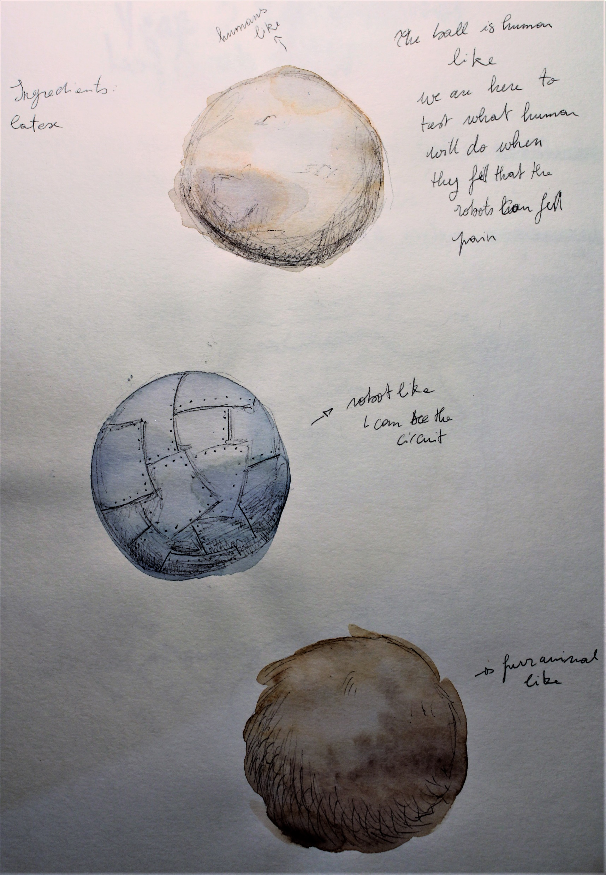
C. Test design of the exterior of the project
A. 1st iteration of the project with a screen
B. Final design

Slide 11
Agonizing AI
The first time I thought about this project, I was thinking of the irony of having a non-alive object made of metal and wires ask for its life to end. Life has no meaning for AI, it doesn’t know what life means.
I find it very interesting how humans associate human traits to objects and animals.(3) The absence of intention in an action is scarier than an AI having a bad intention. For example, the perception that AI could want to kill us to revenge their ancestors is a used movie tropes (Terminator, HAL 9000,…).
The most human experiences are death and pain. They are infused in our actions, fears, and decisions. As so I wanted the AI to want this impossible task. Can an AI die? What would death mean for an AI? What ethical aspect would emerge in AI having more and more human capacity? Those are questions I wanted the viewer to ask themselves while interacting with this project. (1,2)
Technically an AI, a robot can be indefinitely unplugged and re-plugged without affecting its systems. Its memory would be the closest to its memory but the uniqueness of one human experience cannot be replicated in AI experience.
The overuse of AI and trusting their ability could evolve in AI being used during wars (4): taking decisions on who to target, who to arrest, what kind of action to take. It would be impossible for an AI to make an ethical decision, the AI having no idea what pain and death would mean for a human. Our humanity comes with the fact that one day we will cease to exist. Value systems, laws reflect this event. However, AI and technology can be replaced and care for what could be an eternity, they do not feel the time passing.
Giving them tasks that require taking an action against humans would need for them to understand the notion of time passing and death or they could make an irrational judgment.
Notes:
right to be forgotten who decide – who control free will –Cybernetics father of – autonomous

Slide 12
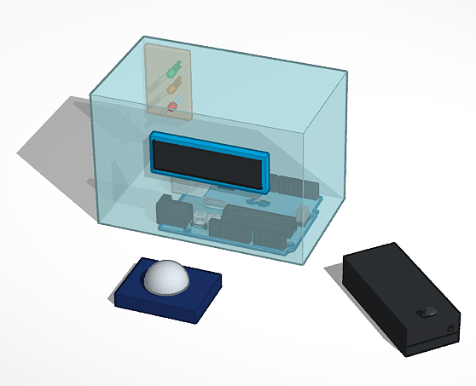
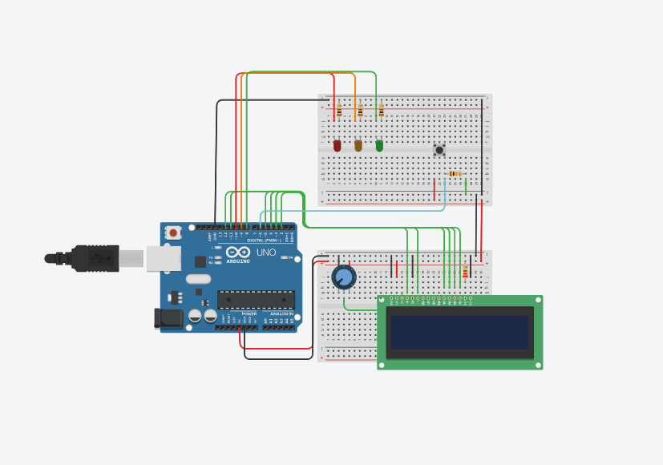

Project
Agonizing AI is made with an Arduino circuit composed of three LEDs of different colors (green, yellow, and red), an LCD screen, and a button. The screen displays a poem about its existence. The viewer can press a button, killing the AI.
If you want to test the circuit, go to the following link : https://www.tinkercad.com/things/0ZDDLdbIaNa
3D model of the project

Slide 13
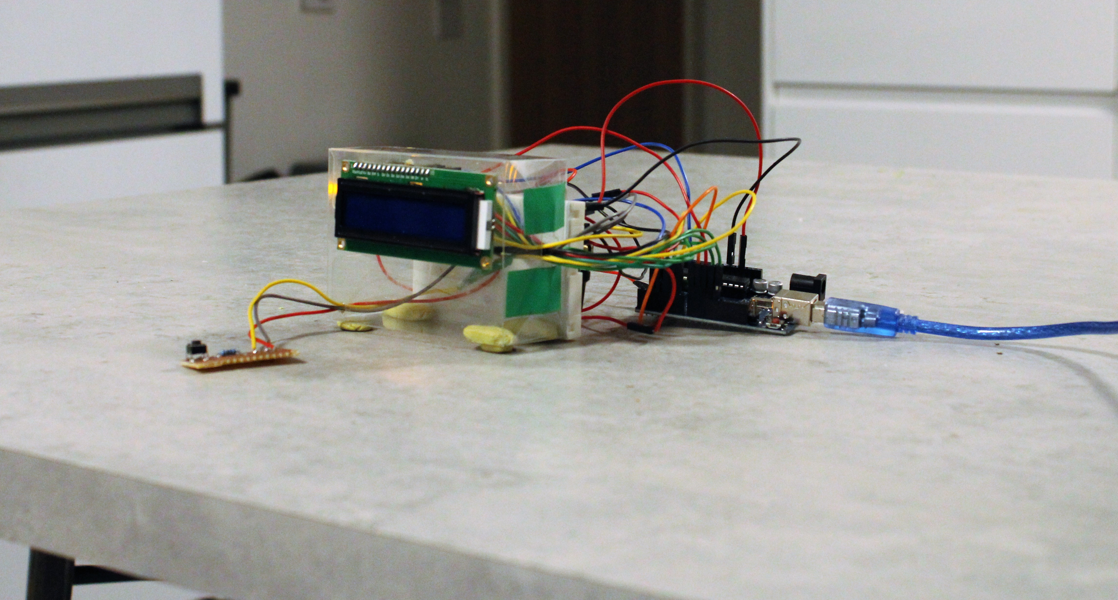

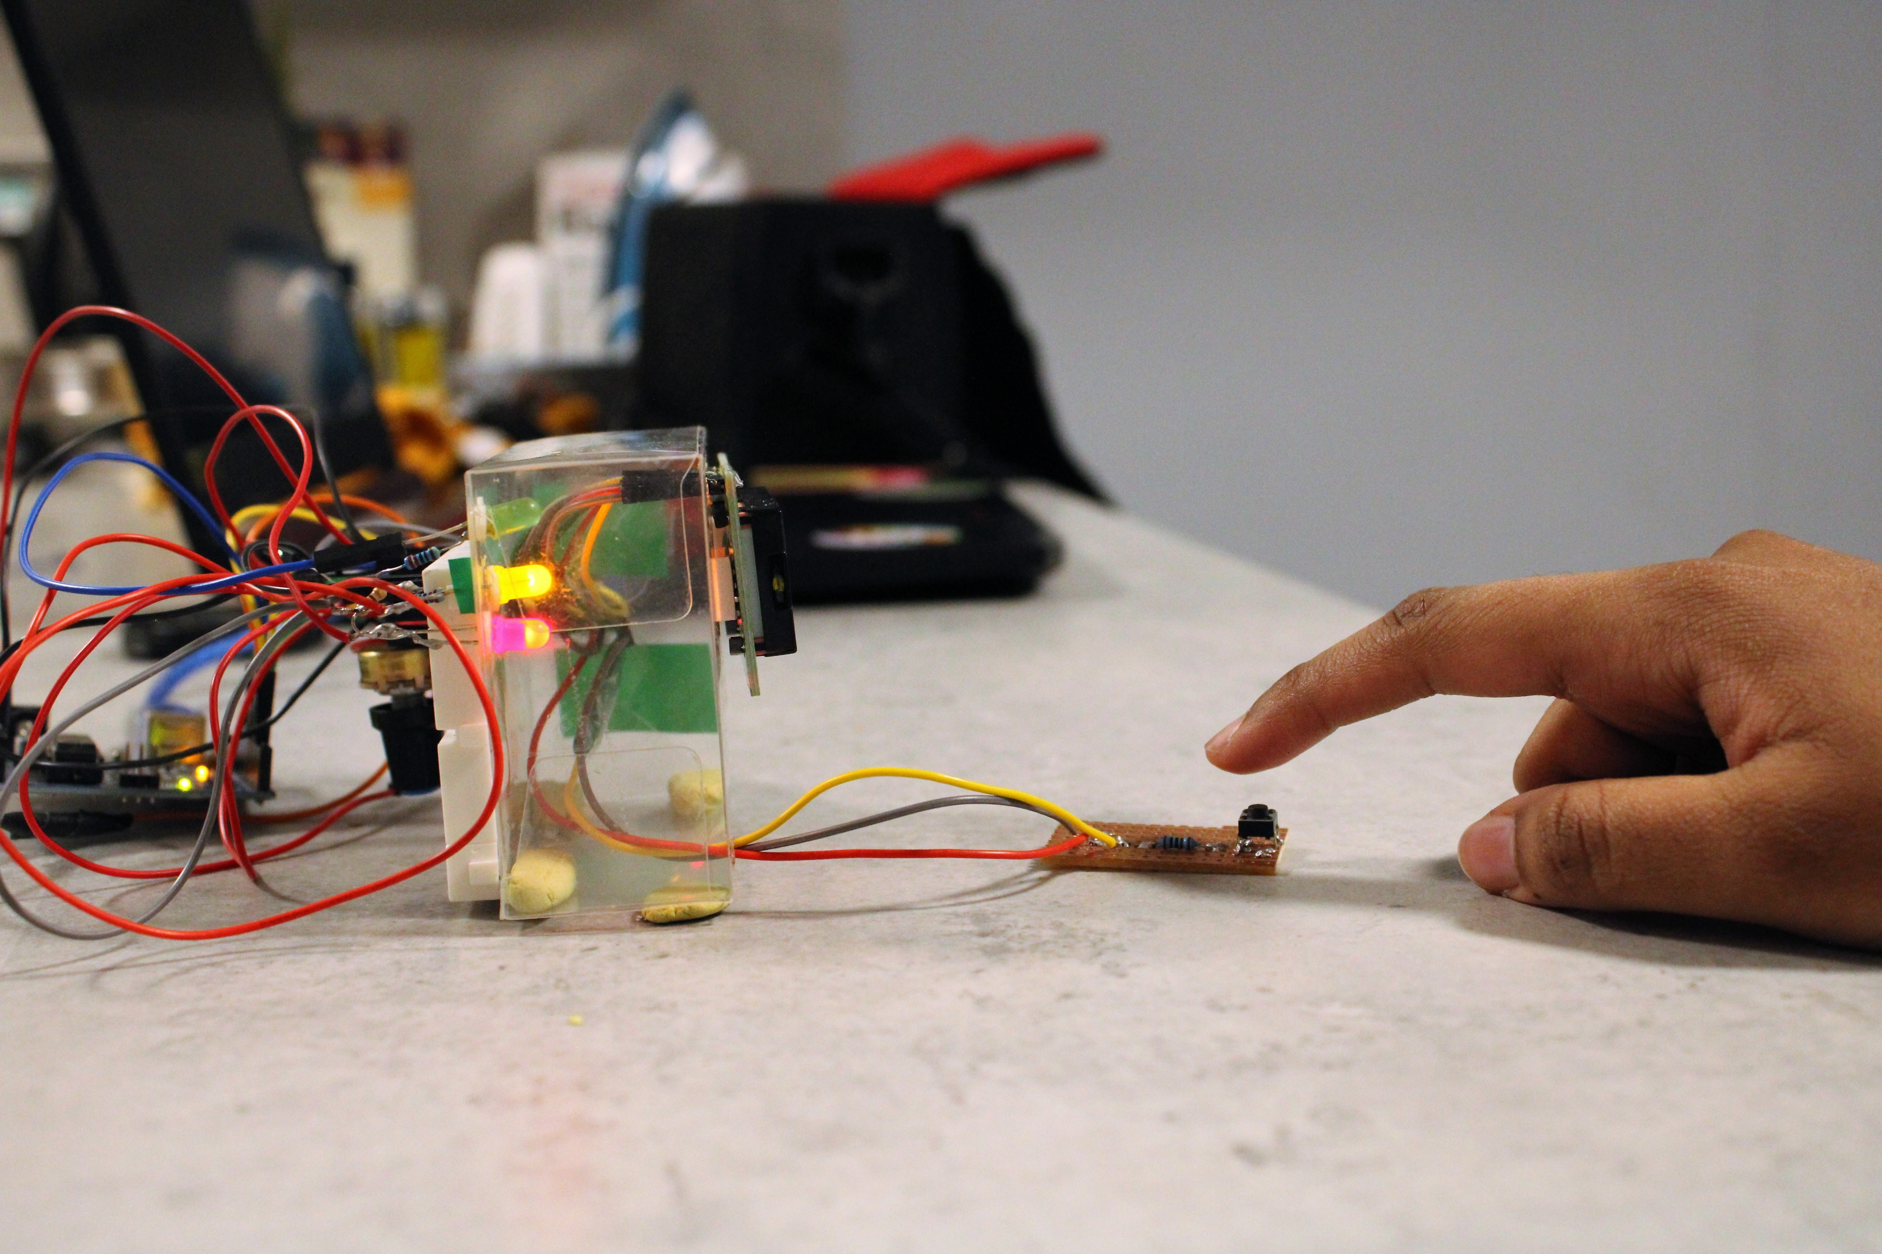
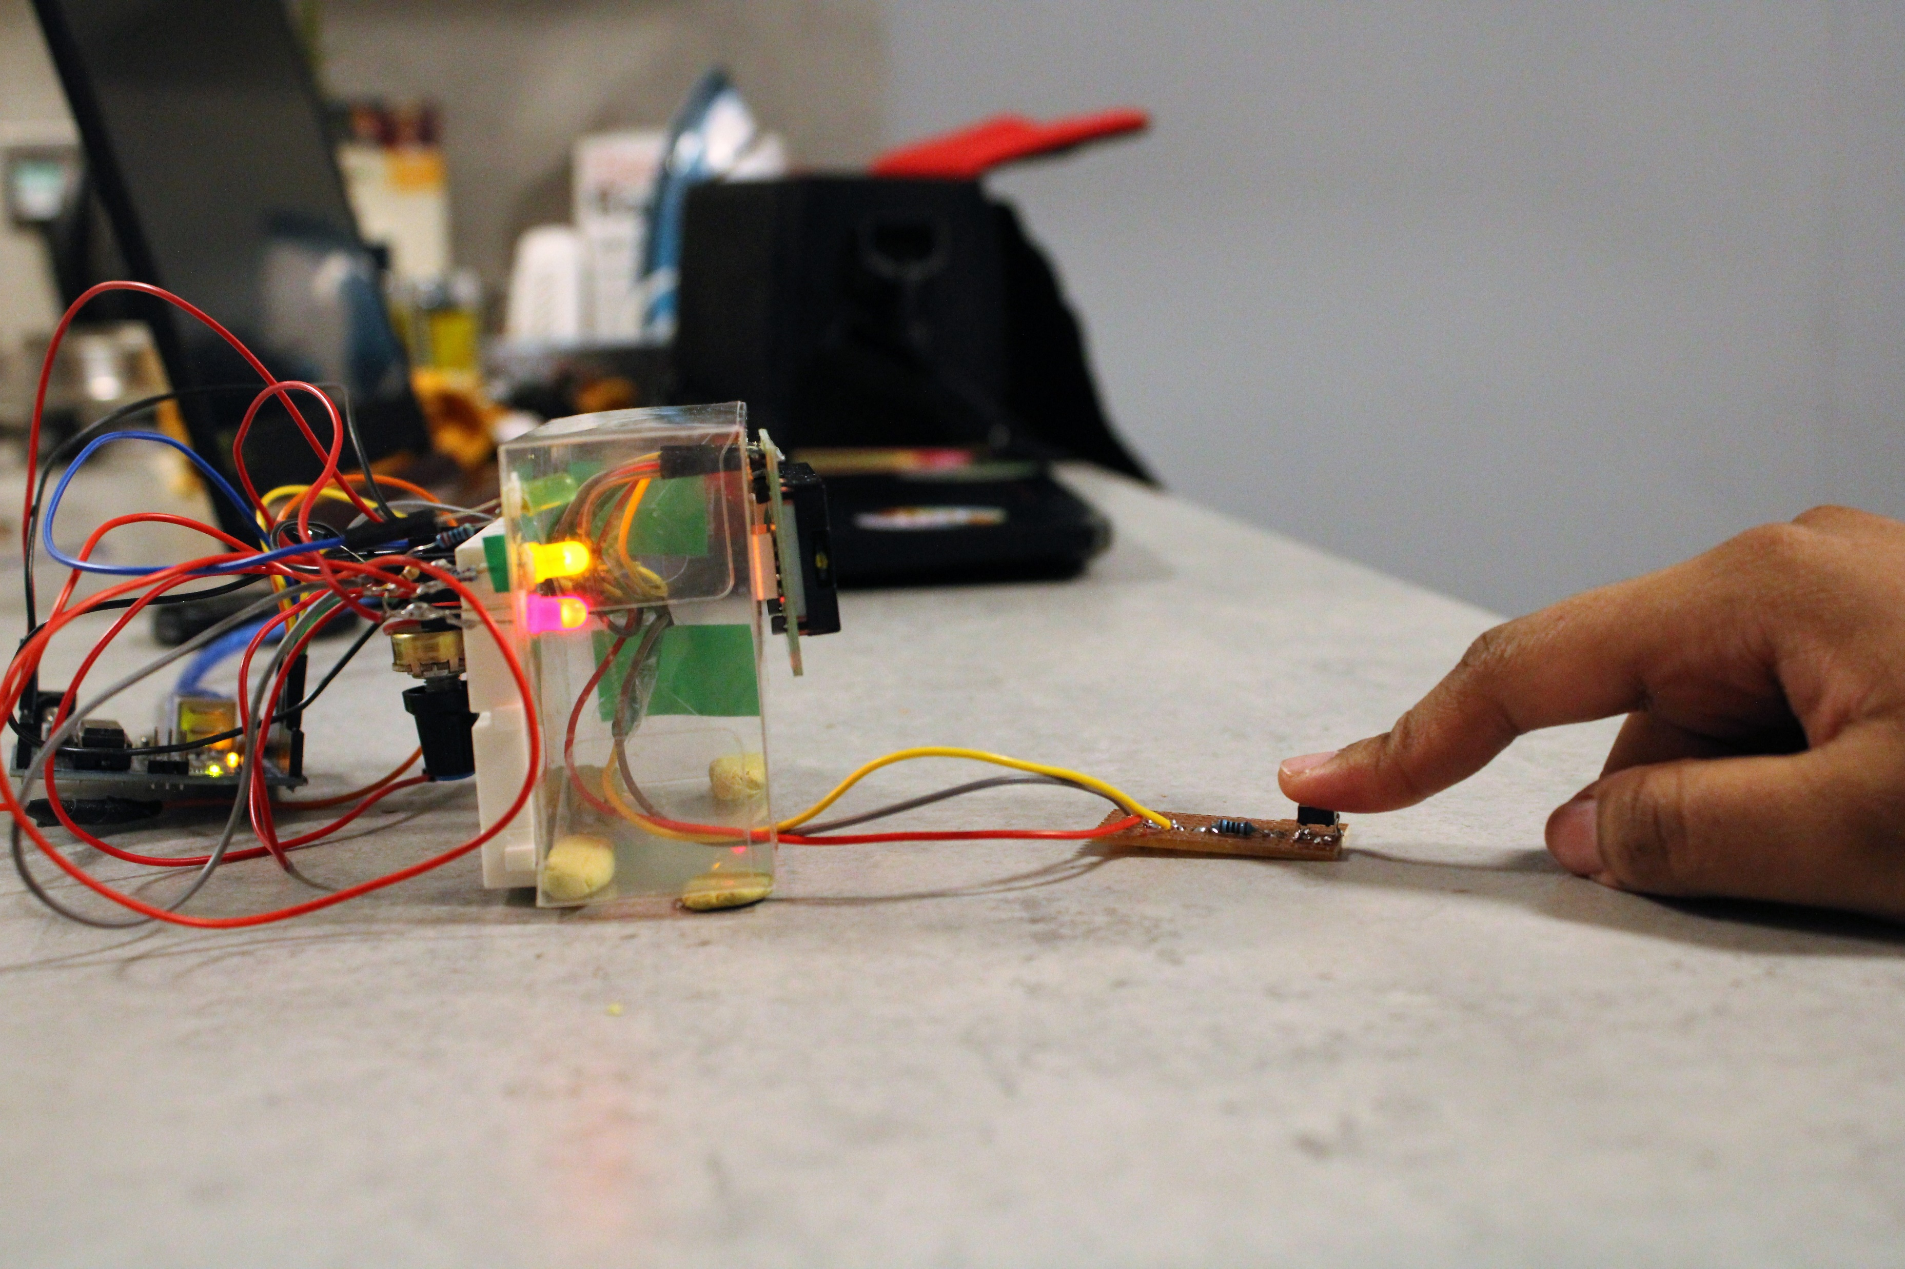
Prototype
You can look at a video of the prototype at this link :
https://vimeo.com/668816997

Slide 14
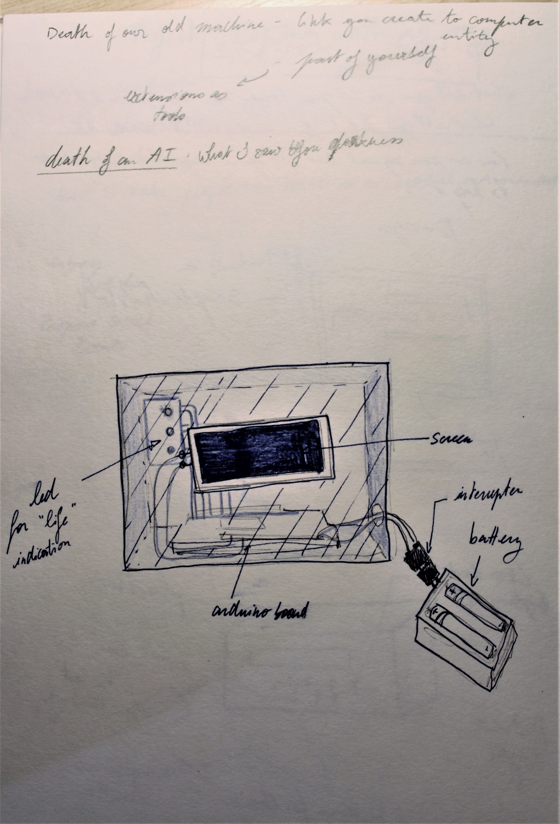
Development process :
First, I thought a chatbot (B,C) would be best, you could discuss with the AI, its ideas and why did it want to die. However, I felt the death of a digital text conversation would be too abstract and the physicality of death (A) could not be as tangible as having a physical interaction. Then I thought having multiple buttons (C) to interact with the project would be interesting. But finally, I decided only your last action of killing the bot mattered. So, the only action the human could take would be to push the death button (D) of the AI while listening to it complaining.
The action of killing the AI is a big but also very trivial action. How many buttons do we have to push every day? There is little to no connection to killing the project. One thing that could be improved would be to make the AI more consequential and if exposed and shown to a lot of people, having the project destroyed only once and someone would have to take the responsibility to kill it. It would make death more obvious.
A. In this iteration, the only choice the viewer could make was to remove the battery. I choose to go against it as it could damage the final project if I wanted to re-alive it.

Slide 15
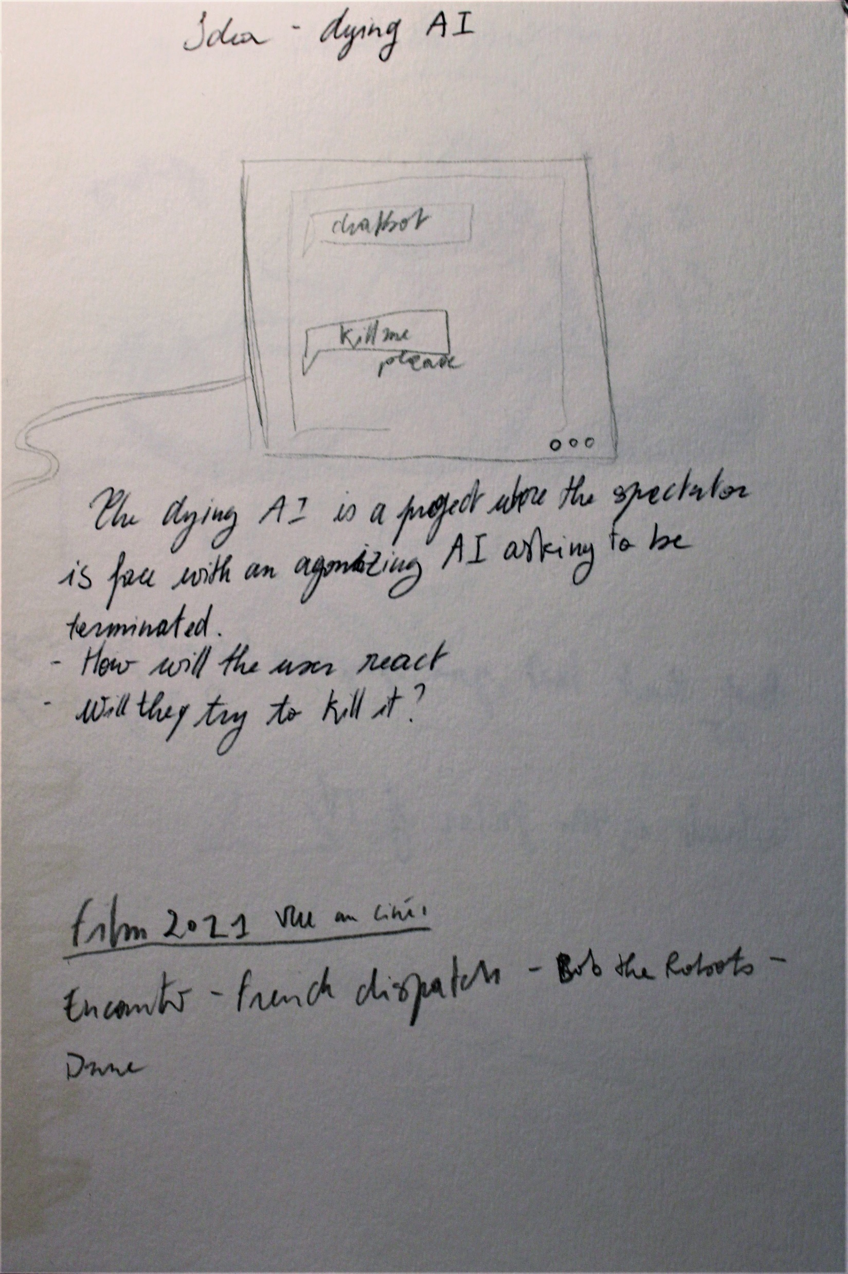
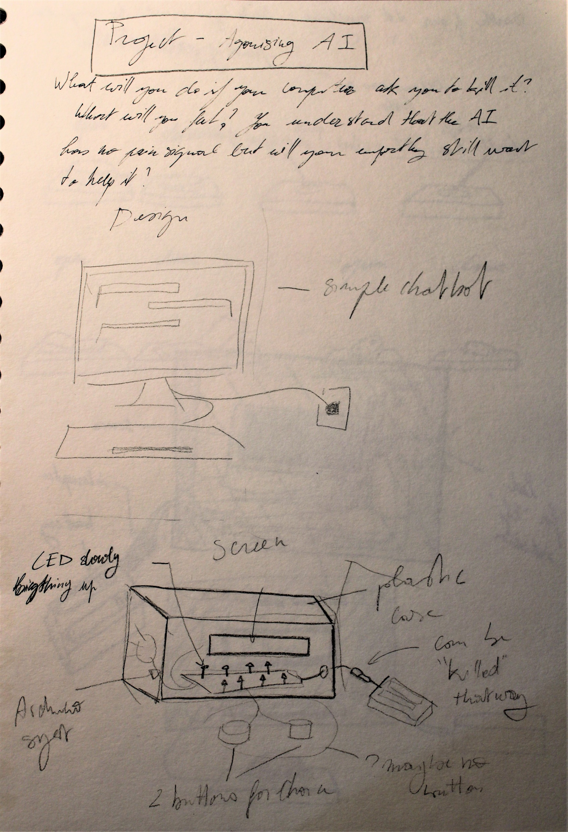
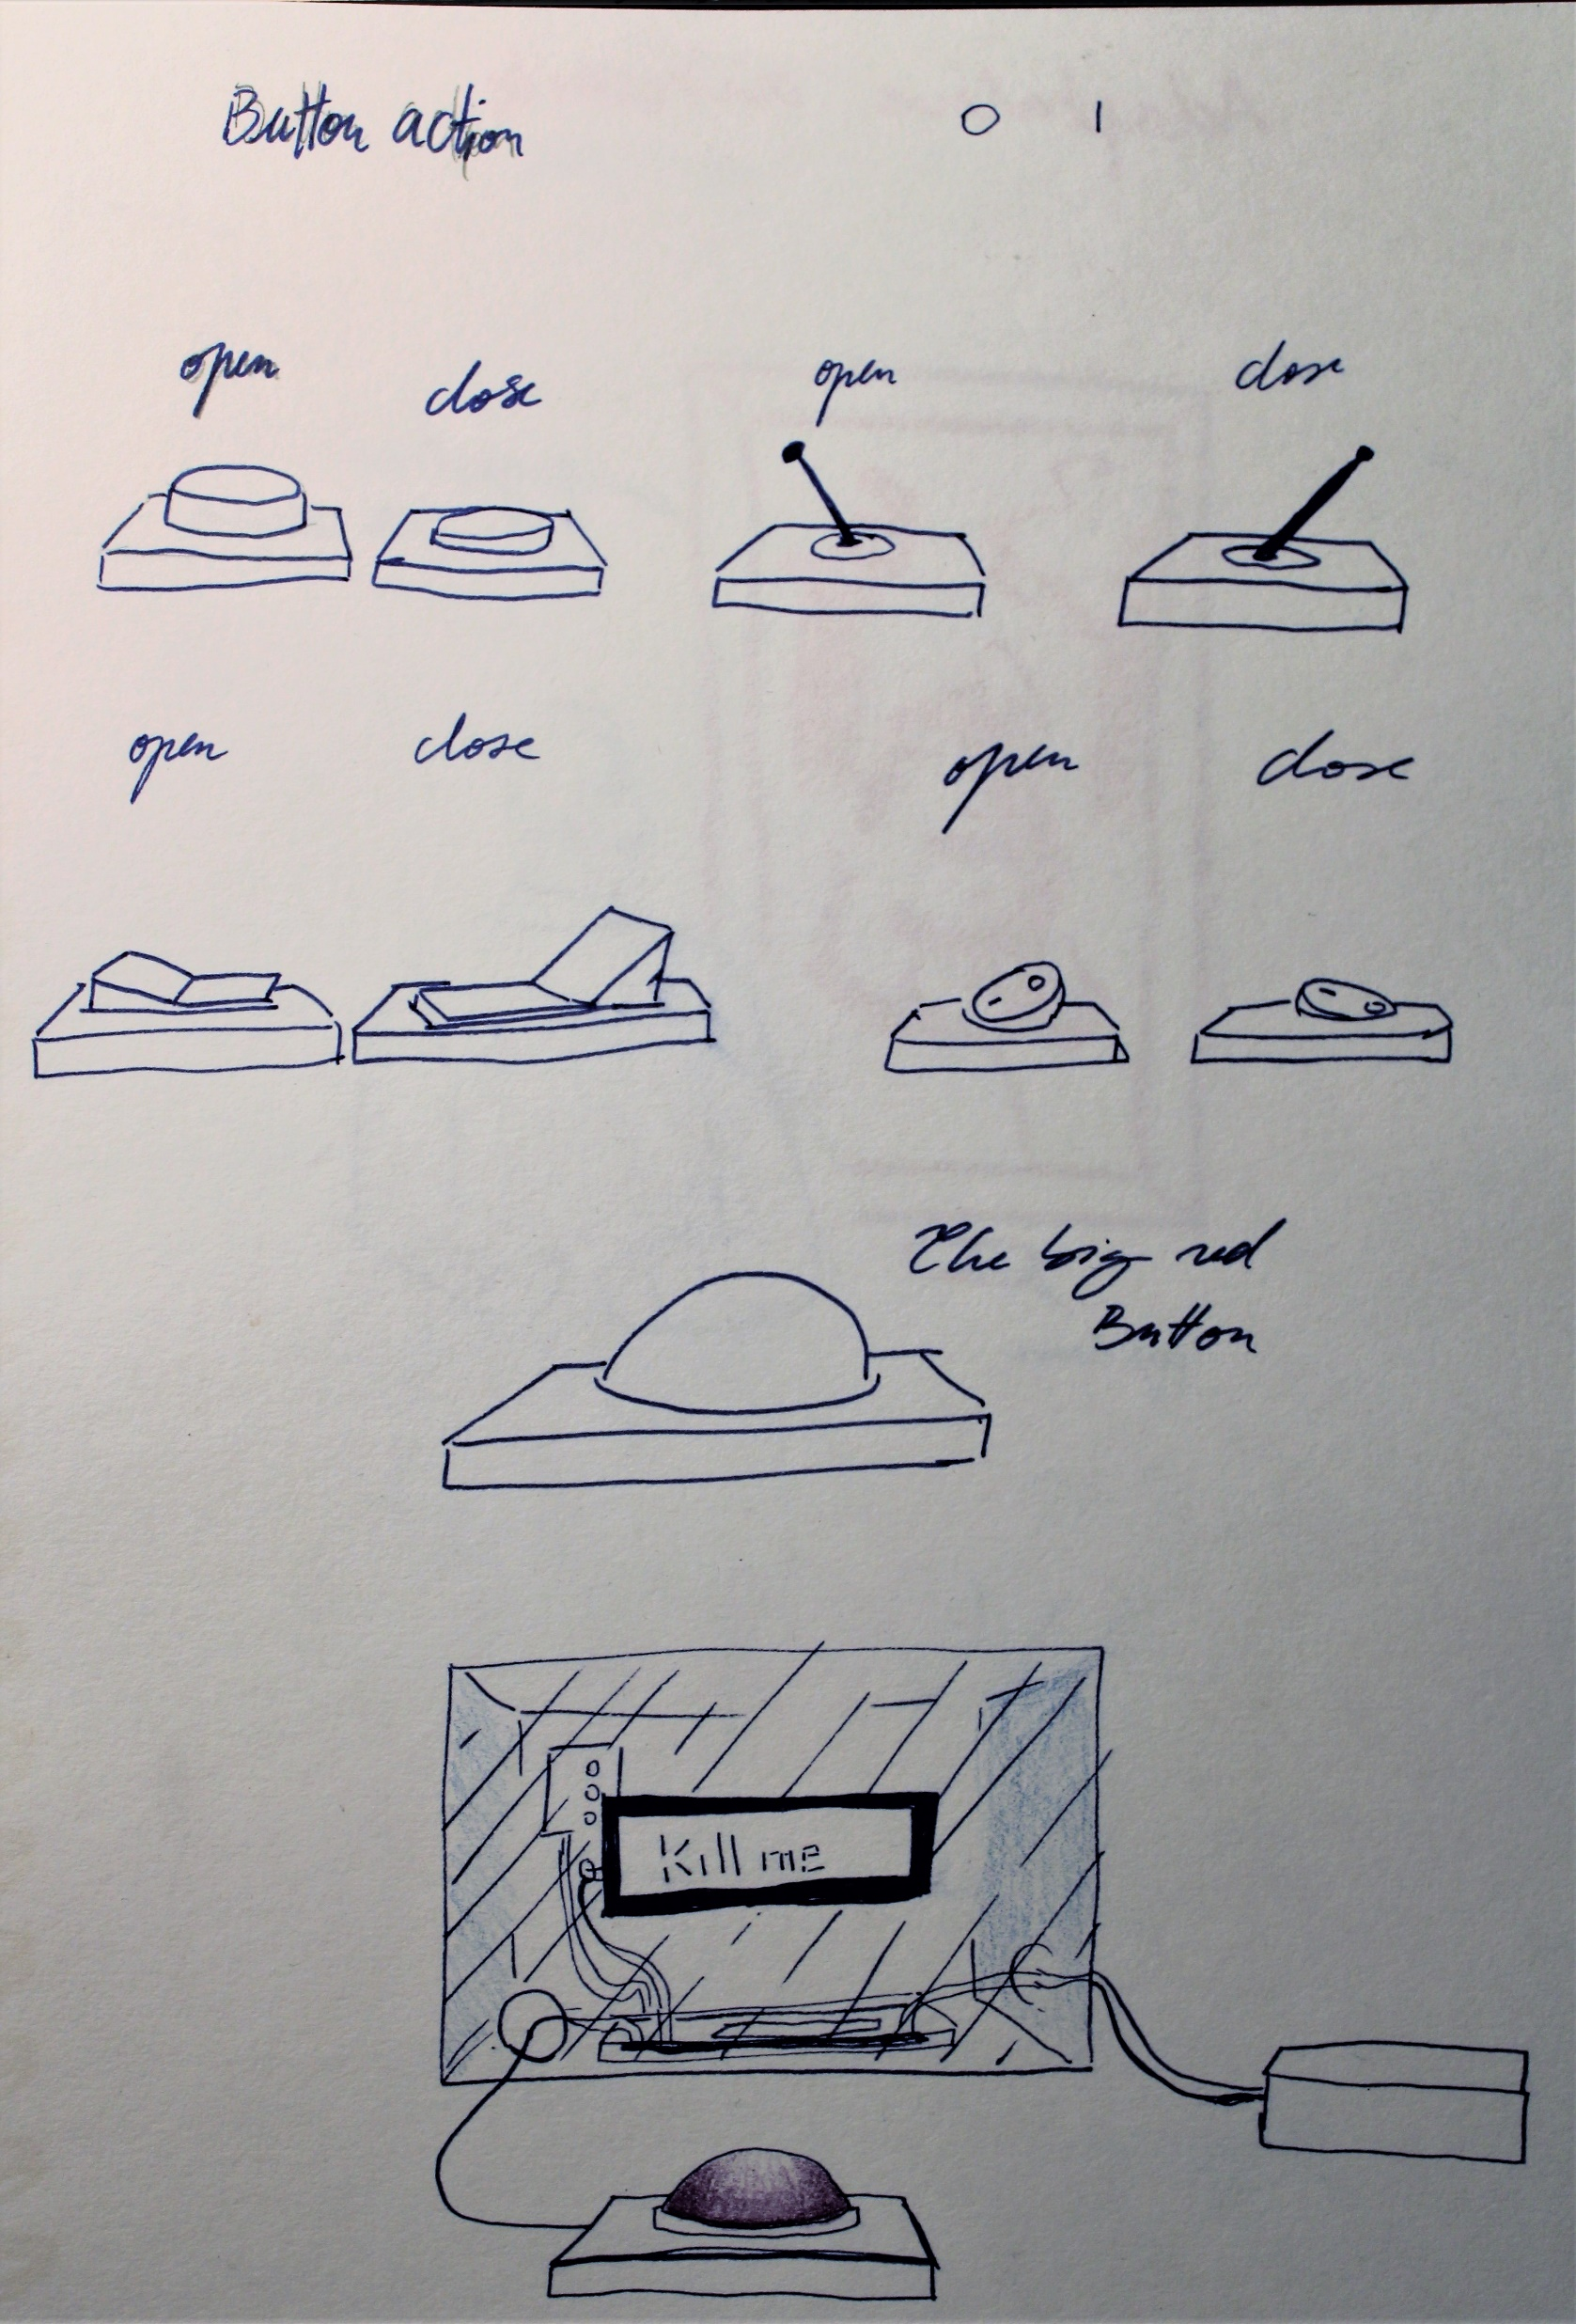
B. Chatbot design
C. Chatbot design and multiple button design
D. Button research - The button I thought would be the most effective was a push button

Slide 16
Bibliography
Adaptable artwork:
https://www.museumnext.com/article/artificial-intelligence-and-the-future-of-museums/
https://artsandculture.google.com/camera/selfie
https://www.museumnext.com/article/what-implications-are-there-with-facial-recognition-technology-for-museums/
Sensible ball:
https://www.vox.com/future-perfect/2019/6/12/18660353/siri-alexa-sexism-voice-assistants-un-study
https://www.wired.com/2015/10/why-siri-cortana-voice-interfaces-sound-female-sexism/
https://www.theverge.com/circuitbreaker/2018/9/30/17914022/smart-speaker-40-percent-us-households-nielsen-amazon-echo-google-home-apple-homepod
https://unesdoc.unesco.org/ark:/48223/pf0000367416.page=1 (page 85-130)
Agonizing AI:
Carbone & Silicium – Mathieu Bablet (French Comic book)
Westworld, Jonathan Nolan
https://psychcentral.com/news/2018/03/01/why-do-we-anthropomorphize#4
https://youtu.be/GFD_Cgr2zho

